Slide 1
Receptor Channels
By comparing the measured current amplitudes and duration distributions with the predictions of various hypotheses, an investigator can determine how ions interact with a channel molecule and how the interaction between a transmitter and its receptor controls the opening and closing of the channel.
In synapses of the central nervous system, amino acids such as glycine, gamma-aminobutyric acid (GABA) and L-glutamate are the most prominent signaling substances for rapid communication.
The pulse-like shape of the currents measured for channels that bind these transmitters indicates that they, too, open and close randomly.
The receptor channels may therefore work in essentially the same way as do the acetylcholine receptor channels at the end plate.
Nevertheless, transmitter-gated channels in the central nervous system often show an additional complexity, in that some channels may be only partially open or closed and that different subtypes of the channels may occur in various brain regions.

Slide 2
Receptor Channels
The transmission of information from the central nervous system to the neuromuscular junction needs to be extremely rapid.
In the myelin-coated neuronal axons that carry those signals in vertebrates, conduction is not mediated by transmitter-gated channels like those we have already described.
Instead, it is mediated by faster channels that respond to changes in membrane voltage-the difference in electrical potential between the inside and outside of the cell.
Voltage-gated channels for sodium ions underlie the rapid rise of the action potential in neurons.
Analyses of the elementary sodium currents indicate that the voltage-sensitive channels switch between two states and have a high probability of opening shortly after the beginning of a voltage change.
The currents supporting the nerve impulse are generated by the superposition of tens of thousands of such elementary sodium currents.
Voltage-gated channels for other ions, such as potassium and calcium, seem to operate in much the same way as sodium channels do and share many of the same structural features.

Slide 3
Receptor Channels
Patch clamp investigations have revealed the dynamic molecular mechanisms of transmitter- and voltage-gated channels at a level of finer detail
The elementary event is not a single current pulse but a series of transient pulses separated by brief gaps.
When a receptor channel in the end plate of a neuromuscular junction binds with acetylcholine, for example, it opens and closes several times before the acetylcholine finally dissociates from it.
The structure of these transitions for end-plate channels was investigated
Using probability theory, the number of states an acetylcholine channel adopts during its succession of openings and closings and also the rates of the transitions from one state to another was estimated .
Each receptor has two binding sites for acetylcholine, when both sites are occupied by acetylcholine molecules, the probability that the channel will open is close to 100 percent

Slide 4
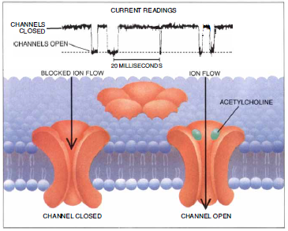
Receptor channels
Figure:
Receptor channels found at the neuromuscular end plate open in response to the transmitter acetylcholine.
When no acetylcholine is present, effectively no current passes through a channel.
When acetylcholine binds to the receptor, an elementary current of a few picoamperes flows.
The measured durations of the currents and the intervals between them vary because the interaction of acetylcholine molecules with the receptors is governed by probability.

Slide 5
Heterogeneity of Membrane Channels
Membrane channels are apparently heterogeneous: in the same membrane patch, two or more classes of closely related channels often seem to be activated.
Pharmacologists have known for many years that different subtypes of receptors exist, but the sharper tools now available in the form of recombinant DNA techniques have shown that the diversity of subtypes is far greater than had been imagined
For each type of transmitter- or voltage-gated channel, there are several versions or subtypes with different conductance or gating properties that form a channel family.
External stimuli and the developmental stage of an organism can alter the mosaic of channel subtypes found on cell membranes.

Slide 6
Genetic Studies
A primary aim in the understanding of membrane channels is to relate their functional properties to their three-dimensional structures
To attain this goal is to locate and change critical sequences of amino acids in the channel protein and then to observe the effect of the alterations on the channel's function.
After the DNA encoding each subunit of the acetylcholine receptor had been cloned and sequenced, it became possible to perform such experiments.
Studies were performed on normal and genetically altered acetylcholine receptor channels in the membranes of host cells, such as eggs from the clawed frog Xenopus.
From copies of DNA that encoded the acetylcholine receptor, complementary messenger RNA molecules in the test tube were synthesized.
These RNA sequences could be injected into egg cells, which then translated the genetic information into receptor proteins and inserted them into the cell membranes.
The functional properties of these recombinant receptor channels closely resembled those of end-plate channels at the neuromuscular junction.

Slide 7
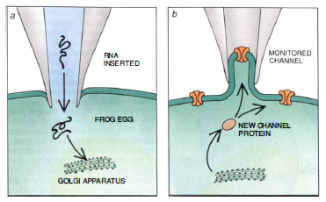
Genetic studies
Figure: Genetically engineered frog eggs are useful tools for studying ion channel behavior.
RNA sequences encoding subunits of ion channels can be injected into an egg
The egg will then synthesize the channel proteins and insert them into its surface membrane, where they are accessible for patch clamp experiments

Slide 8
Subtypes of channels
This combination of techniques helped to elucidate the structural differences between subtypes of end-plate channels in muscle.
Elementary endplate current recordings had revealed that mammalian muscle produces two subtypes of end-plate channels: a low-conductance subtype that appears predominantly in fetal and neonatal muscle and a high-conductance subtype with different gating properties that is expressed in adult muscles.
During postnatal development, the fetal subtype gradually disappears and is replaced by the adult subtype
The shifting mosaic of channel types is generated by changes in the expression of genes that encode the channel subunits.
Similar techniques were also used to locate the amino acid sequences in the acetylcholine receptor protein that form the inner wall of the membrane channel.
An analysis of the amino acid sequences in the subunits had suggested that they each contained four membrane- spanning segments, designated M1 through M4.

Slide 9
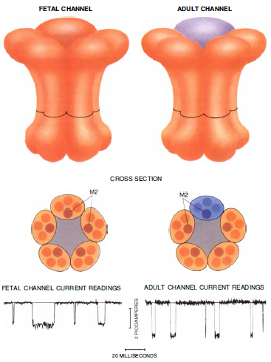
Structure of Acetylcholine receptor channels
Figure: Structure of acetylcholine receptor channels relates directly to their function.
Each channel consists of five subunits, each containing four transmembrane segments.
The M2 segment from each subunit lines the inside of the channel, like a stave in a barrel.
Fetal mammals produce an acetylcholine receptor in their neuromuscular end plates that differs in just one subunit from receptors found in adults.
Because a fetal channel has a subunit that differs in its M2 segment from that of an adult, the elementary currents that pass through it are smaller.

Slide 10
Genetic studies
Through recombinant DNA techniques, author created the genes for chimeric channels, made up of subunits from species (cows and electric rays) whose own channels had different conducting properties.
By analyzing the properties of these chimeric channels, it was found that M2 segment and its neighboring regions contain important determinants of ion transport.
Through directed mutations, it was found that three clusters of negatively charged amino acids may form rings at the extracellular and intracellular mouths of the channel
A similar ring of polar amino acids is present in the transmembrane portion close to the intracellular mouth.
These negatively charged rings drastically influence the rate of current flow and may select particular ions for transport across the membrane: positively charged sodium and potassium ions would be drawn into the channel, and negatively charged chloride ions would be excluded from it.
Results also suggested that the polar amino acids located close to the intracellular part of the M2 transmembrane segment formed the narrowest part of the acetylcholine receptor channel

Slide 11
Voltage clamp analysis
Patch pipettes can also be used to study signaling mechanisms at a cellular level, a procedure called voltage clamp analysis.
Indeed, when measuring events in small cells, the technique has advantages over the use of conventional microelectrodes.
Conventional voltage clamp analysis has contributed immensely to our understanding of signaling processes in the nervous system and was introduced by Kenneth S. Cole in 1949
Hodgkin and Huxley used it to unravel the basic mechanisms of nerve excitability.
The technique involved "taming the axon," as Cole put it, by forcing a transmembrane potential onto the axon of a neuron.
The resulting membrane currents could then be measured and interpreted.
Unfortunately, most voltage clamp techniques require that either axial wires or at least two microelectrodes be inserted into a cell, which is generally possible only with the largest types of animal and plant cells.

Slide 12
Voltage clamp analysis
Mammalian cells having diameter of 10 to 30 microns and can barely tolerate impalement with a single standard micro electrode.
the best understood signals in plant cells were those of giant algae, not those of corn, wheat or sugar beets.
The ability to create a giga-ohm seal between a patch pipette and a cell membrane literally opened up mammalian and other small cells.
It made measurements of membrane channels possible, also it enabled researchers to apply voltage clamps to small cells.
A researcher could rupture the clamped membrane patch without breaking the tight seal between the pipette and the surrounding membrane, thereby obtaining access to the cytoplasm.
That configuration, termed whole-cell recording, resembles a classic micro electrode impalement.
It is tolerated by much smaller cells, however, and it provides much better control over the intracellular milieu

Slide 13
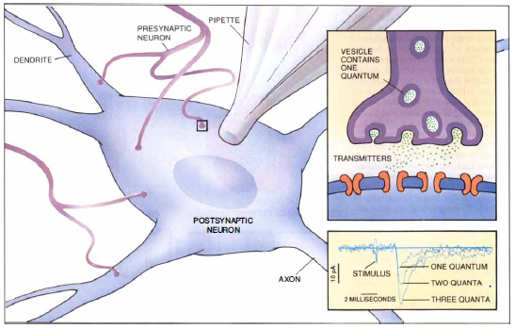
Whole-cell recording
Figure:
Whole-cell recording, in which a patch pipette takes the place of a conventional microelectrode, has revolutionized the study of mammalian cells, neurons in particular.
Researchers can work on small slabs of neural tissue containing neurons that are still in contact with their neighbors.
The technique is sufficiently sensitive to detect excitatory and inhibitory currents induced in the neurons by individual quanta (packets) of transmitters contained in single presynaptic vesicles (inset).

